Slide 1
COMMON AGRICULTURAL POLICY Post-2020
AKIS in post 2020 CAP, including EIP and advisory services integrated within AKIS
Inge Van Oost - DG AGRI
Unit B2 – Research & Innovation
Athens, 24 February 2020
^{#FutureofCAP}

Slide 2
The AKIS at the heart of the agricultural innovation ecosystem
What is an Agricultural Knowledge and Innovation System (AKIS)?
What: AKIS is the organisation and interaction of persons, organisations and institutions who use and produce knowledge and innovation for agriculture and interrelated fields. (def)
Who: The main players of the AKIS are: farmers/foresters, advisors, researchers, (farmer) organisations, NGOs, networks, retailers, media, services, various ministries…: they all produce and need knowledge!
Why: The aim is to create a regional/national innovation ecosystem by enhancing knowledge flows between the AKIS players as well as strengthening links between research and practice.
Brief "What is AKIS": https://ec.europa.eu/info/sites/info/files/food-farming-fisheries/key_policies/documents/building-stronger-akis_en.pdf

Slide 4
The EIP-AGRI in short
2010: European Innovation Partnerships want to speed up innovation through cooperation and linking existing policies and instruments
EIP "Agricultural productivity and sustainability" launched in 2012: "more and better from less", "ideas put into practice with success", impact by end-users becoming "actors" and motivated
The EIP-AGRI applies an overarching "Open innovation" concept based on the interactive innovation model (applied in RD Operational Groups and H2020 Multi-Actor projects):
Collaboration between various actors to make best use of complementary types of knowledge (scientific, practical, organisational, etc) in view of co-creation and diffusion of solutions/opportunities ready to implement in practice.
EU wide EIP network linking actors: communication, partnering, dissemination, knowledge flows and collecting practice needs (Open science)

Slide 5
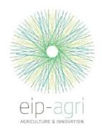
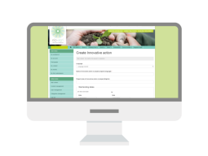
Connecting policies:
the bigger EIP picture
CAP/Rural development
(regional/national level)
Research projects
Multi-actor projects
Thematic networks (interactive innovation)
Farmers
NGOs
Advisors
Operational
Group
Agri- business
Researchers
EIP network(s)
OG preparation
OG projects
Innovation support services
OPERATIONAL GROUP
Involvement of OGs is strongly recommended
Spread
the results
Unique EU knowledge repository
of contacts and practice abstracts
Notes:
How does the EIP-AGRI work in practice?
The EIP-AGRI benefits from a unique set of measures and instruments funded under two European policies working in close synergies: Horizon 2020 and the rural development pillar of the CAP.
Operational Groups (local interactive innovation projects) are the cornerstone of the EIP-AGRI under the CAP and support the development of innovations by groups of relevant actors in a fully bottom-up manner. These groups hold huge potential for creating innovative solutions that will make farming smarter, more efficient and more sustainable. Today almost 900 Operational Groups have started under the rural development programmes.
We expect 3 200 such Operational Groups by the end of 2020.
While Operational Groups are working at regional and national levels, over 150 European and international research and innovation projects funded under Horizon 2020 are working on similar issues related to agriculture and rural areas. A cornerstone of the projects is "the multi-actor approach", in which actors with complementary knowledge work together to design innovative solutions that have high chances to be implemented in practice.
EU wide EIP-AGRI network linking actors: communication, partnering, dissemination, knowledge flows and collecting practice needs (Open science)
Horizon 2020 Multi-actor projects
Engage with EIP-AGRI operational groups
Can help create them… or the other way round?
Horizon 2020 Thematic networks
Translate knowledge into practice
Boost impact of all activities
EIP-AGRI Operational groups
Solve specific problems on the ground
Inspire wider European activities
EIP-AGRI Focus groups
Enrich programming
Build multi-actor communities for Horizon 2020
Inspire projects (OGs or Horizon 2020)
EIP-AGRI Networking activities
Enhance knowledge exchange

Slide 6
EIP-AGRI – Where are we?
27 Member States, 98 rural development programmes voluntary implementing the EIP
Around 3 200 OGs planned in 2014-2020; more than 1500 OGs already running or finished, still 4 years to go
Around 180 H2020 multi-actor projects (1 bio €), including 39 thematic networks
A growing and thriving network
www.eip-agri.eu
An increasing volume of practice-oriented knowledge !

Slide 7
From EIP-AGRI to AKIS Strategic Plans & Green Deal relevance: what is changing?

Slide 8
Provisions on modernisation in the CAP Strategic Plan Regulation post 2020
Funding innovative projects…..
…..will now be supported by a whole innovation ecosystem systematically interlinking people and projects (AKIS)

Slide 9
THE 9 COMMON OBJECTIVES
Continuation of support for preparing and implementing OG innovative projects, as well as for EIP networking (Art 113,114), contributing to ALL 9 specific objectives
^{INCREASE COMPETITIVENESS}
^{REBALANCE} ^{POWER IN FOOD CHAIN}
^{ENSURE} ^{VIABLE INCOME}
^{CLIMATE CHANGE}
^{ACTION}
Cross-cutting objective KNOWLEDGE & INNOVATION
^{THE 9}
^{CAP}
^{ENVIRONMENTAL}
^{CARE}
^{OBJECTIVES}
RESPOND TO CITIZENS' CONCERNS in terms of
^{FOOD & HEALTH QUALITY}
^{PRESERVE}
^{LANDSCAPES} ^{& BIODIVERSITY}
^{SUPPORT} ^{GENERATIONAL RENEWAL}
^{VIBRANT} ^{RURAL AREAS}
9

Slide 10
THE 9 COMMON OBJECTIVES
^{INCREASE COMPETITIVENESS}
^{REBALANCE} ^{POWER IN FOOD CHAIN}
^{ENSURE} ^{VIABLE INCOME}
^{CLIMATE CHANGE}
^{ACTION}
Cross-cutting objective KNOWLEDGE & INNOVATION
^{THE 9}
^{CAP}
^{ENVIRONMENTAL}
^{CARE}
^{OBJECTIVES}
RESPOND TO CITIZENS' CONCERNS in terms of
^{FOOD & HEALTH QUALITY}
^{PRESERVE}
^{LANDSCAPES} ^{& BIODIVERSITY}
^{SUPPORT} ^{GENERATIONAL RENEWAL}
^{VIBRANT} ^{RURAL AREAS}
10

Slide 11
Intervention logic for modernisation, innovation and knowledge flows:
Overview of relevant AKIS provisions
Art 5
Cross-cutting objective of modernisation, knowledge sharing, innovation and digitalisation
Strategic approach to plan CAP interventions
Art 102 Modernisation in CAP Strategic Plans:
Well-functioning AKIS:
research + advisors + CAP networks +… working together ….and digitalisation
Art 113
CAP networks:
Fostering innovation and knowledge exchange
Tools = targeted CAP interventions to support the strategy:
Art 72
Funding for knowledge exchange, advice and information
Art 71
Cooperation:
Funding for preparing and implementing EIP OG projects
Art 13
Details on Advice and Innovation support to be given
Art 114
Details on EIP and OGs,
Interactive innovation model
Notes:
Art 102: "AKIS = the combined organisation and knowledge flows between persons, organisations and institutions who use and produce knowledge for agriculture and interrelated fields" => a more inclusive AKIS inducing better knowledge flows supported through interventions in MS’ CAP Strategic Plans, supported by advisory services and networking activities
Art 114: EIP interactive innovation model principles as basis for innovative solutions: actors with complementary knowledge cooperate to tackle concrete farmers'/foresters' needs and opportunities, EIP Operational Group innovation projects support all CAP objectives
Art 13: Impartial advisors to be fully integrated in AKIS, providing services covering economic, environmental and social dimensions and delivering up-to-date technological and scientific information developed by research and innovation (=> farm advisory "services" replacing the current FAS "system"), "innovation support" => advisory services in particular to support EIP OGs for preparing and implementing innovative projects (= innovation project brokering, innovation project facilitation, etc)
Art 71: Funding for EIP OG projects through the "cooperation" intervention (= ex M16)
Art 72: The intervention "knowledge exchange & information" funding supports receiving one-to one advice, organising information actions, setting up advisory & innovation support services, etc (=ex M1&M2)
Art 113: CAP networks at EU level and national levels should "foster innovation and knowledge" flows (=support EIP networking) and thus will contribute to a well-functioning AKIS

Slide 12
AKIS in CAP Strategic Plans (Art.102 - modernisation)
The CAP Strategic Plans shall contain:
Their contribution to the cross-cutting general objective related to fostering and sharing of knowledge, innovation and digitisation, notably by describing:
The organisational set-up of the (existing) AKIS (=> SWOT)
How advisors, researchers and CAP networks will work together within the framework of the (future) AKIS, and
How advice and innovation support services are provided
A description of the strategy for the development of digital technologies in agriculture and rural areas

Slide 13
MINISTRY OF THE ENVIRONMENT AND SPATIAL PLANNING
legislation
MINISTRY OF AGRICULTURE, FORESTRY AND FOOD
MINISTRY OF ECONOMIC DEVELOPMENT AND TECHNOLOGY
MINISTRY
OF HEALTH
MINISTRY OF EDUCTION, SCIENCE AND SPORT
SLOVENIAN ENVIRONMENT AGNCY
AFSVPP*
science
education
PUBLIC SERVICES
LIVESTOCK
CROP PRODUCTION
FORESTRY
PLANT PROTECTION
VETERINARY …
COORDINATION BODY OF AKIS ?
3 FACULTIES
12 HIGH SCHOOLS AND COLLEGES
3 RESEARCH INSTITUTES
COORDINATION
OF PUBLIC SERVICES
PUBLIC SECTOR
ENSURING
OF ADVISORY
SERVICES
INSTITUTIONS
FOR LOCAL DEVELOPMENT
MEDIA
FARMERS’
ADVISORY SERVICE
FARMERS’
ORGANIZATIONS
FARMERS
PRIVATE SECTOR
COOPERATIVES
FARMERS’
UNION
Operational Groups
(EIP)
PRIVATE ADVISORS AND
COMPANIES
COOPERATION
NGO
KNOWLEDGE TRANSFER
*THE ADMINISTRATION OF THE REPUBLIC OF SLOVENIA FOR FOOD SAFETY, VETERINARY AND PLANT PROTECTION
NEED TO strengthen
Notes:
The researches focus is on the basic research while work on the applied research is significantly smaller.
The key focus of education programs on faculties and in secondary schools is technology, thought students do not get enough knowledge on farm management (economy) as well as sustainable management. The whole knowledge (priorities) chain must be rebuilt.
- CAFS has strong political power and it has a very difficult task in balancing farmers’ interests with government’s interests.

Slide 14
Art 13 and 72: Farm advice organised within the AKIS structures in CAP Strategic plans
Advising farmers and other beneficiaries of CAP support to be included in the CAP plans
All advisors shall be integrated within the AKIS in an inclusive way, to be able to cover economic, environmental and social dimensions and to deliver up-to-date technological and scientific information developed by R&I
Advisors must be impartial and be able to provide Innovation support, in particular for preparing and implementing Operational Group projects of the EIP AGRI
Notes:
Member States shall include farm advisory services in the CAP Strategic Plans

Slide 15
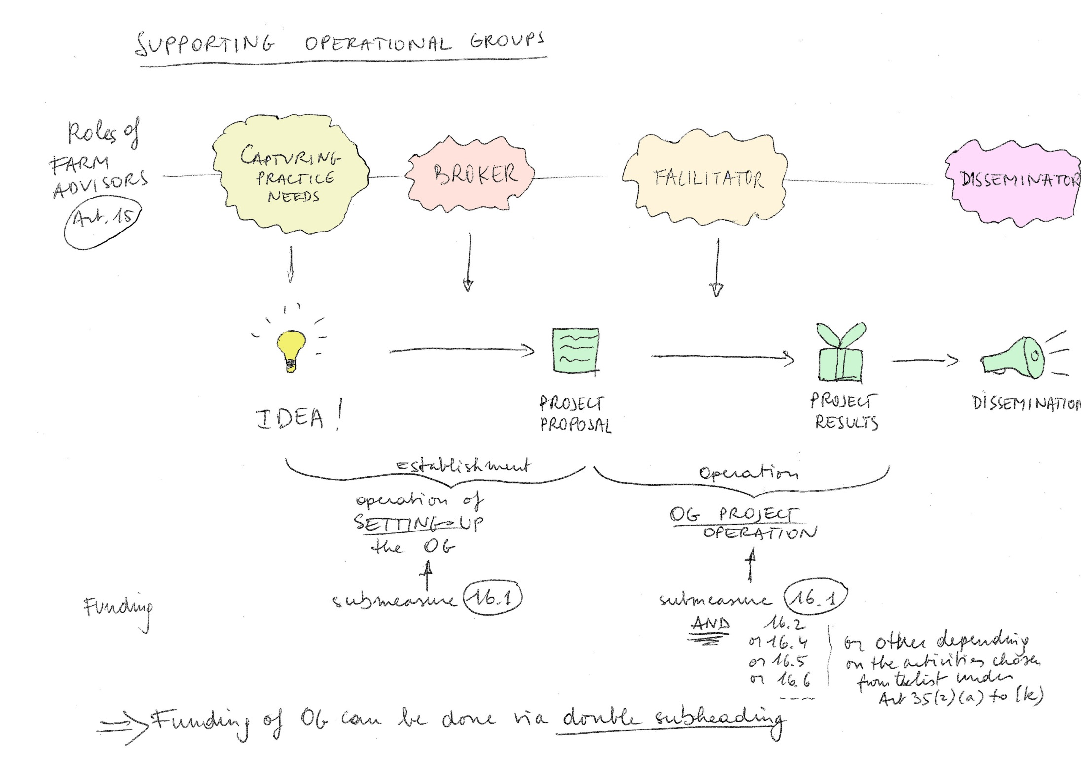
New roles for farm advisors in interactive innovation projects
Preparing
OG proposal
Running
the OG project
Farm advisors/innovation support services’ role in interactive innovation processes:
Capture practice needs
Broker to set up interactive innovation projects
Facilitate interactive innovation projects
Disseminate newly generated knowledge
+ ……
Notes:
Innovation brokering function
How to capture ideas?
Capturing bottom-up ideas from the grass-roots level
Getting an innovation project ready to start by acting as a go-between: helping single actors which might have difficulties in finding the adequate partners
A close connection with and understanding of agriculture is important
A cross-cutting approach beyond existing sectors, regions, initiative and institutes may bring added value
Different approaches may be useful e.g. vouchers etc ("simplified cost") for easier use and reduction of administrative burden

Slide 16
Example of an Innovation Support Service:
one to one innovation brokering
A farmer
Innovation
support
centre
Companies
selling
bacteria
products
Ammonia
reducing pig stable
group
Researchers
VITO (environm)
ILVO (agric)
Project objective: develop a pig stable reducing ammonia emissions by 50 % in a more cost-efficient way than existing stable systems (idea from a farmer, brokered by the Innovation Support Centre)

Slide 17
Example (BE): Innovation Support Service http://www.innovatiesteunpunt.be/en/projects/agrispin-innovation-brokership
Brokering function
Coordination and facilitation of projects as an intermediate between partners
Innovation promotion and awareness raising
Coaching farmers towards innovation (individual advice)
Brainstorming events and thematical animation
Biannual innovation prize: 150 candidates, 10 final prizes, one winner - and a lot of communication in the farm journals promotes innovation
Dissemination of innovative results
Connect with SMEs and other innovation services and funding bodies
(see example of innovation project "Distrikempen" video from Agrispin H2020 project)
https://www.youtube.com/watch?v=fbiAGzlf3IA logistic innovation short supply chain

Slide 18
Skills for Innovation brokers
Skills for Innovation brokers
Be able to listen to understand exactly the problem/opportunity and the context
Be capable to analyse the problem/opportunity: how can it be tackled in the best possible way (costs, actors, funding source etc)?
Have a good network to find people and information
Have intermediating skills to seek compromises where needed
Be quality orientated: plans made have to work out eventually, responsibilities taken, don’t create audit problems
Where useful, think out of the box and do not defend your own position/research

Slide 19
Innovation brokering function - How to capture ideas?
Capturing bottom-up ideas from the grass-roots level
Getting an innovation project ready to start by acting as a go-between: helping single actors which might have difficulties in finding the adequate partners.
A close connection with and understanding of agriculture is important.
A cross-cutting approach beyond existing sectors, regions, initiative and institutes may bring added value
Different approaches may be useful e.g. vouchers etc ("simplified cost") for easier use and reduction of administrative burden – Art 77
19
Notes:
19
19

Slide 20
How can CAP networks help strengthening innovation and knowledge exchange on all 9 CAP objectives?
Collecting and sharing outcomes of 3200+ EIP OGs from current CAP
Collecting and sharing outcomes of 180 H2020 multi-actor projects + Horizon Europe
EIP website + knowledge reservoirs being prepared under H2020
Connecting OGs with Horizon projects = great added value
All this material provides great input for local AKIS actors (farmers, advisors, businesses, researchers,..): training for advisors and farmers, peer-to-peer events, demonstrations, website, e-learning, ISS etc
Organising events to link and network AKIS actors for future cooperation
Start now, already testing future interventions under current period and brainstorm in AKIS coordination platforms
Notes:
The Commission shall establish a European Innovation Partnership for agricultural productivity and sustainability (EIP).
Operational groups funded under the cooperation type of intervention (art. 71)

Slide 21
TOOLBOX FOR A KNOWLEDGE- BASED AGRICULTURE
Cross-cutting objective on knowledge, innovation and digitalisation (CAP Art. 5)
Strengthening of MSs'/regions' Agricultural Knowledge and Innovation Systems (AKIS)
Specific budget of EUR 10 billion in Horizon Europe for food, agriculture, rural development and the bio-economy.
Each CAP strategic plan will include a section on how to stimulate the exchange of knowledge and innovation & digital technologies in agriculture (CAP Art. 102)
Support for advice, training, innovation and knowledge exchange in Rural Development (CAP Art. 71,72,13,… )
^{Continuation of}
the agricultural European Innovation Partnership (CAP Art 113, 114)
Notes:
21

Slide 22
The Horizon 2020/Horizon Europe (HE) dimension of the EIP-AGRI
=> induces the need for intensifying CAP innovation networking and efficiency of Horizon Europe National Contact Points

Slide 23
CAP post 2020 – AKIS, EIP, advice and innovation – state of play negotiations (1)
Council Working Party: AKIS related discussions as good as finalised:
MS are overall happy with Commission proposal, including:
Continuation of support for preparing and implementing OG innovative projects, as well as for EIP networking (Art 113,114)
Higher than normal EU co-funding for OG projects (up to 80%), (OGs in average 150-200.000 euro)
Possibility of advance payments for OG projects (up to 50%)
- Principles of interactive innovation now explicit in regulation (as in 2014 EIP guidelines):
1) focus on practical farmers’ needs
2) co-creation and co-decision all along the project
3) complementary knowledge in the OG necessary: farmers' involvement is key
(Idem Horizon 2020 WP page 11-13, and Horizon Europe)
=> Do not underestimate the enterpreneurial creativity of farmers in OG projects for innovation, e.g. IE example of an OG testing and preparing an Agri-Environmental measure (AKIS report: see box page 63)

Slide 24
CAP post 2020 – AKIS, EIP, advice and innovation – state of play negotiations (2)
Obligation to integrate and update advisors' competences through connections within the AKIS (Art 13), e.g. on up-to-date R&I and economic, ecological and social domains
Obligation and funding to provide innovation support (Art 13)
Broad CAP support for almost any type of knowledge exchange and advice (Art 72) ⬄ limitations in former FAS, as well as in Art 15 advisory support in current RD regulation
A number of further improvements since June 1018:
Art 3: definition of AKIS
Art 72: coherence: linking the support for knowledge exchange & advice with AKIS strategies
Art 114: introduction of funding cross-border OG projects (as from the start)
Art 113: introduction of the possibility for existing OGs to cooperate, funded by Technical Assistance or Art 72 => CROSS-FERTILISATION
European Parliament: compromise amendments voted on 2/4/2019: no substantial changes
New Parliament: positive, no substantial changes

Slide 25
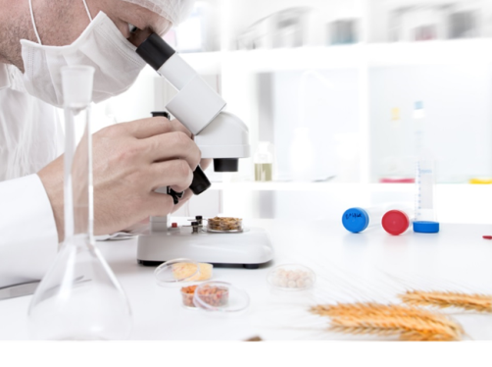
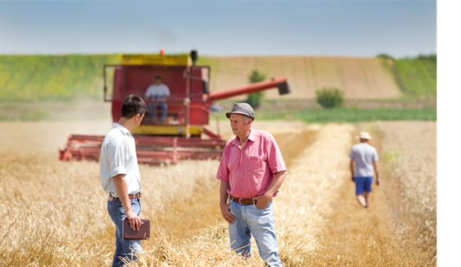
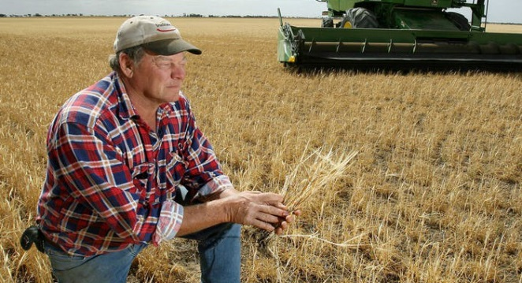
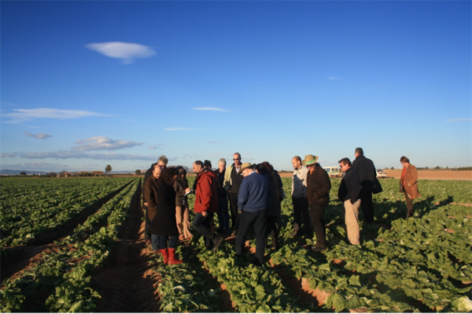
An integrated approach
supporting modernisation, innovation and knowledge flows
AKIS
Researchers
Advisers
Farmer
at the centre of the integrated Agicultural Knowledge and Innovation System (AKIS) to support modernisation, innovation and knowledge flows
Businesses
Education
Organisations
Media

Slide 26
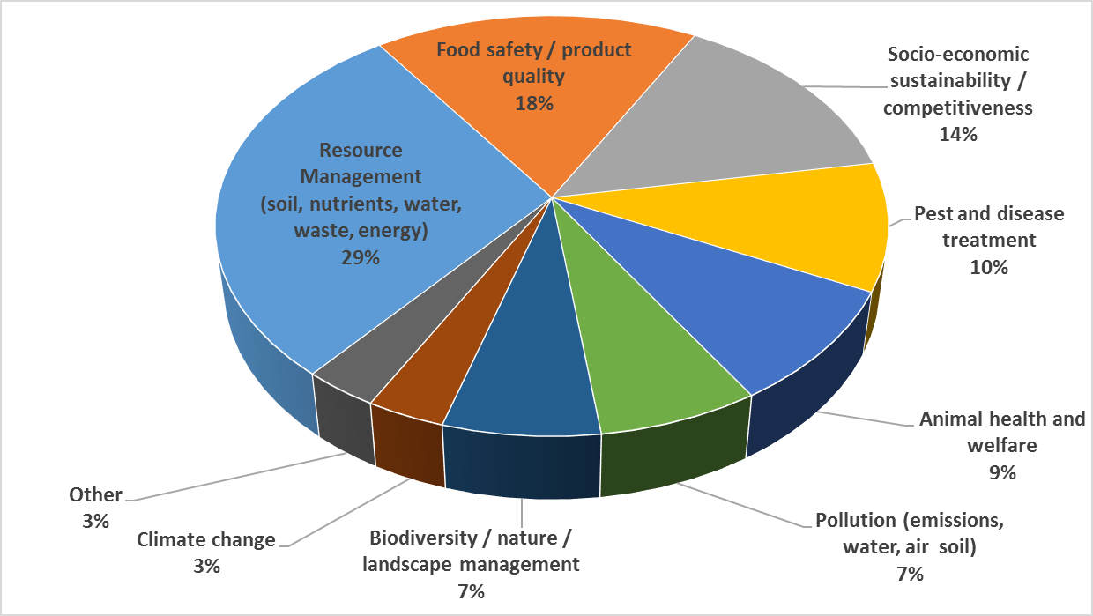
EIP OGs assessment – clustering analysis (data Feb 2018) :
65% OGs are climate/environment related
A huge variety of agricultural challenges/
opportunities tackled in OGs
Source: OG assessment, by IDEA, Sept 2018

Slide 27
AKIS & EIP-AGRI – preparing for EU knowledge reservoir(s) for practice serving back-offices for innovation support and advice
MS already creating dbases (EIP-AGRI in DE, FR, back-office and ISS in LT etc)
EURAKNOS project (Thematic Network of Thematic Networks, midterm Jan 2020)
EUREKA project (feasibility EU knowledge reservoir for practice, kick-off Jan 2020)
Making an increasing volume of practice-oriented knowledge accessible and attractive!
www.eip-agri.eu

Slide 28
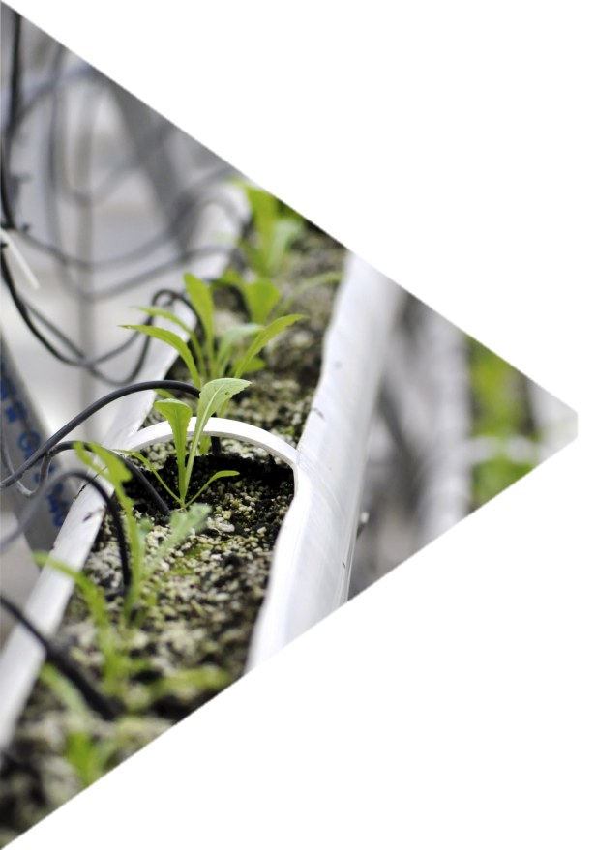
Conclusions 2018-2019 study on OGs => IMPACT ON PRELIMINARY AKIS STRATEGIC PLANS https://ec.europa.eu/eip/agriculture/en/publications/eip-agri-operational-groups-assessment-2018 (Idea Consult)

Slide 29
Conclusions
Confirmed great interest in the EIP-AGRI OG framework and instrument
Since launch of study, number of OG has increased to about 1500 now
Some MS launch a set of OG calls, both open and thematical aspects => MS INSPIRED BY EACH OTHER FOR AKIS STRATEGIC PLANS
91% of OGs are positive about their experience and would recommend other actors/organisations to become involved in an OG project => CONTINUATION OGS EXPECTED IN AKIS STRATEGIC PLANS

Slide 30
Conclusions => PRELIMINARY FINDINGS FROM DRAFT AKIS STRATEGIC PLANS
OGs focus on tackling farmers’ needs in a practical and collaborative way
OG partnerships are indeed set up to co-develop new/adapted methods, tools, solutions, directly applicable by farmers
OGs prove a unique, versatile and flexible framework to address various concrete bottom-up farmers’ challenges/needs: from 30.000 Euro to 25 mio Euro per OG MORE TYPE OF OG CALLS EXPECTED ACCORDING TO PRELIMINARY AKIS STRATEGIC PLANS, LESS COOPERATION PROJECTS
OGs do connect the farmer’s community with complementary external expertise to help solve these challenges in variety of partnership compositions AKIS COORDINATION BODIES, AKIS KNOWLEDGE PLATFORMS AND INNOVATION SUPPORT SERVICES IN EACH MEMBER STATE

Slide 31
Conclusions
Partnership and project structures in three circles help connecting and disseminating to farmers’ communities
OG partnership usually consist of a few core partners, complemented by group of partners for practical parts of the project (2nd circle)
Regular interaction and involvement of wider target group built into project structure through testing & demo activities
3rd circle of up to 100 farmers/end-users not formally part of the partnership, testing new solutions in real farming practice and providing direct feedback
This structuring ensures efficient project coordination while providing practical feedback mechanism and dissemination channels to farmers’ community
Farmers are still reluctant to take administrative lead as they lack the capacity and resources to deal with the related obligations (pre-financing) SOLVED!

Slide 32
Conclusions
Outcomes and dissemination
OGs devote substantial attention to dissemination in a variety of ways throughout the project
OGs interestingly link rural-agricultural community with other sectors and industries
OGs can test and prepare the field and motivate beneficiaries for agri-environmental measures in the next RD programme OGs BECOME TESTBED FOR CAP MEASURES
Support
OGs satisfied with administrative support received: useful advice from Managing Authorities
Innovation support services are important in setting up the right partnership structure and preparing the application (now only 12%) OBLIGATION FOR ALL MS

Slide 33
Conclusions
OGs as vehicles to connect to other (rural) innovation initiatives and actors
OGs discovering the collaboration potential beyond the scope of the own OG, and interested to explore further, even though no priority in current period yet
90% of OGs established relations with organisations outside the partnership or intend to do so, even though the current funding framework cannot cover all the costs for this => MS START TO SEE BETTER THE EU ADDED VALUE AND WANT TO GO CROSS-BORDER
Need to better facilitate this, e.g. by more structured and accessible information on the themes and approaches of OGs
OGs would welcome more pro-active support for this by national/regional support structures
=> AKIS COORDINATION BODIES, AKIS KNOWLEDGE PLATFORMS AND INNOVATION SUPPORT SERVICES IN EACH MEMBER STATE

Slide 34
How does this translate to the drafting of the CAP Strategic plans and indicators?

Slide 35
Overview of AKIS, advice and EIP in CAP post 2020
Relevant articles (see also reference to 2013-2020 articles/measures):
An more inclusive AKIS with better knowledge flows as part of MS’ CAP Strategic Plan (Art 102 - new)
EIP OGs supporting all CAP objectives (Art 114, replacing Art 53)
EIP interactive innovation model defined (Art 114 - clarification)
Impartial advice, all advisors inclusively integrated in AKIS (Art 13, new) => replacing FAS (system) by the AKIS (system)
Innovation brokering and facilitation - supporting EIP OGs (Art 13, new)
OGs use Cooperation intervention for funding OGs (Art 71 => M16)
AKIS uses Knowledge exchange & information (Art 72 => M1 & M2)
CAP networks at EU level and National/regional levels to support EIP and AKIS coordination activities (Art 113 => before: Art 52-57)
Notes:
AKIS = the combined organisation and knowledge flows between persons, organisations and institutions who use and produce knowledge for agriculture and interrelated fields

Slide 36
CAP Plan template
8. Modernisation and Simplification
8.1 Modernisation: AKIS and digital technologies
How the CAP Strategic Plan will contribute to the cross-cutting general objective related to fostering and sharing knowledge and innovation, including:
Identification of the needs, based on the evidence from the SWOT analysis, in relation to the cross-cutting objective related to fostering and sharing of knowledge innovation and digitalisation, including relevant information from the SWOT analysis about the functioning of the AKIS and related structures;
Overall organisational set-up of the AKIS, including planned actions to improve knowledge flows in particular between advisors, researchers and CAP networks;
Description of the farm advisory services provided, which shall cover economic, environmental and social dimensions and deliver up to date technological and scientific information developed by research and innovation;
Description of how advisory services, research and CAP networks will work together within the framework of the AKIS, and how advice and innovation support services are provided;

Slide 37
CAP Plan template
7. Governance systems and coordination systems
7. 1 Identification of governance and coordination bodies
Body | Contact details
Competent Authority
Managing Authority
Paying Agency (ies)
Coordinating Body (if applicable)
Certification Body
Monitoring Committee
Other delegated and intermediate bodies not laid down in the Regulation, with a description of their role
AKIS coordination, including farm advice
Relevant coordination body(ies) for the AKIS
Whenever the draft Regulation provides for the possibility to establish governance bodies at regional level, and Member States make use of this possibility, this Chapter will include information on all these bodies.

Slide 38
Milestones of Advisory Services under the CAP
CAP
Pillar I
Pillar II
2003 (introduction cross compliance)
2007 Obligatory ”Farm Advisory System” (FAS) all MS must make up a list of dedicated advisory services in support of cross-compliance as a package
2014 FAS moved into horizontal legislation (Art 12-15 R. 1305/2013) covering both CAP pillars
2021 AKIS system replaces FAS system (simplification)
=> Cross-cutting objective on Knowledge and Innovation for the whole CAP
2007-2013: Support for vocational training and advisory services
2014-2020: Knowledge and advisory measures further developed (e.g. training of advisors, only specific elements to be advised on, not the full CC package)
2021-2027: ”Farm Advisory Services” = RD support for all advisors to be integrated in the AKIS according to Art 102 strategy + Art 72 interventions (incl SCO Art 77) to be designed in coherence with CAP AKIS Strategic Plan (Art.102) made after SWOT (Art.103)

Slide 39
Advisory Services under the CAP post 2020
CAP
- One CAP regulation: Advisory services to be included in the CAP Strategic plans (Art 13(1))
- One Cross-cutting objective on Knowledge and Innovation in support of all CAP 9 specific objectives (Art 5)
- Funding for farm advisors and various knowledge exchange activities (Art 72)
- Art 13(3): Impartial advice (no conflict of interest)
- Art 13(2): Advice must be available on a wide range of issues such as:
Economic, environmental and social dimensions
Up to date technological and scientific information developed by R&I
Therefore advisors to be integrated within the AKIS
Art 13(4):
List of fields to cover within the Member State, including innovation support
- Support for advisors from CAP networks’ actions for innovation
Notes:
2000-2006
Training was already included but not advise
Statutory management requirement and good agricultural and enviroment conditions. Occupational safety standards.

Slide 40
CAP Plan template
4. 4. Elements common to several interventions
4.4. Technical Assistance
Objectives;
Scope and indicative planning of activities;
Beneficiaries.
4.5. CAP Network
Summary overview and objectives of the National CAP Network, including activities to support knowledge flows within the AKIS.
Structure, governance and operation of the National CAP Network

Slide 41
Knowledge exchange and information under rural development (Art 72):
Examples of interventions contributing to R.2 result indicator
 | R.1 | R.2 | R.3 | R.24
Examples of interventions contributing to integration of advisors within the AKIS (R.2) | Modernisation Farm | Number of advisors integrated within AKIS | Digitisation Farm | Env/clim performance through knowledge
1. Training of advisors (O.29) | √ | √ | √ | √
2. Back-office work (=specialist support collecting practice knowledge) by advisors (O.29) | ( √ ) | √ | ( √ ) | √
3. Advisors' mobility budget (O.29) | √ | √ |  | ( √ )
4a. Providing innovation support for OG on social care farming (O.2 or O.1) | √ | √
4b. Providing innovation support for OG on short supply chains in HNV areas (O.2 or O.1) | √ | √ | ( √ ) | √
5. Advisors leading thematic networks compiling knowledge for practice (O.29) | ( √ ) | √ | ( √ ) | ( √ )
6. Advisors leading on-farm demonstration events (O.29) | √ | √ | ( √ ) | (√ )
41

Slide 42
COMMON AGRICULTURAL POLICY Post-2020 Legislative proposals
Designing CAP Strategic Plans to improve the structuring of AKIS: Ideas for interventions have been collected in the SWG SCAR AKIS 4 report
^{#FutureofCAP}

Slide 43
CAP AKIS Strategic Plans: potential interventions to strengthen AKIS
(SWG SCAR-AKIS Athens,Tallinn, Dublin)
Enhancing knowledge flows and strengthening links between research and practice: incentivise researchers for their impact beyond academia, e.g. in their careers, by making practice ready outputs, meet practitioners frequently/thematic events, organise on-farm demonstrations where farmers and researchers meet and talk, education for researchers on interactive innovation approaches etc
Strengthening farm advisory services within MS' AKISs: capturing and sharing farmers' needs, acting as innovation brokers/facilitators, participating in and sharing knowledge from OG innovative projects, advisors' training and thematic events to update knowledge, cross-visits (learning peer-to-peer), spend time with researchers,…
Incentivising interactive innovation projects (OGs, H2020 MA): help connecting actors, facilitating cross-border and transnational calls/knowledge exchange, establish innovation support services to develop projects and capture farmers' foresters needs and innovative ideas, support intergenerational renewal by experts' collaboration…
Support digital transition in agriculture: EIP OGs on digital innovation, build and use repositories with agricultural data for multi-purposes, digital skills development,…
Notes:
The Commission shall establish a European Innovation Partnership for agricultural productivity and sustainability (EIP).
Operational groups funded under the cooperation type of intervention (art. 71)

Slide 44
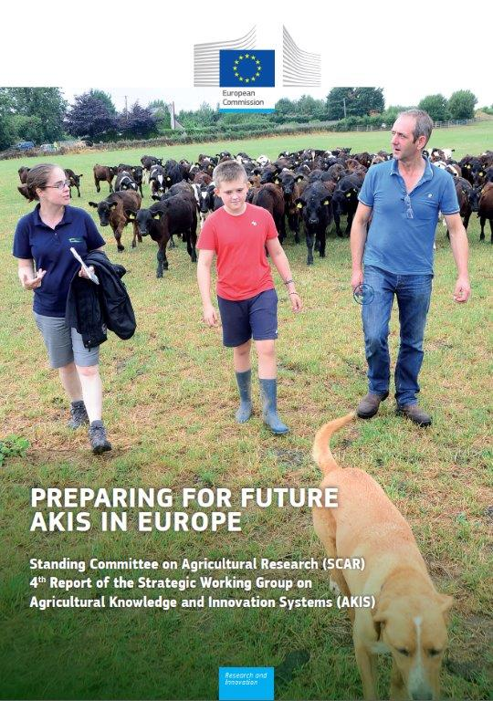
Examples and ideas for CAP AKIS Strategic plans of MSs (SCAR AKIS members) ,
as collected in the AKIS 4 report
section 1.5 of the SCAR AKIS 4 report

Slide 45
1.5.5 General remarks about Strategic CAP AKIS plans
A financial envelope is needed: a certain proportion of the CAP budget should be spent on the various ways of improving the AKIS (strands 1-4 hereafter) to ensure that the issue is taken serious and that the plan is implemented with real actions. For instance "target"/ringfence a dedicated part of CAP funding to knowledge and innovation, e.g. 10%
We need public knowledge, coherence & the flexibility to make it happen.
Develop the strategic AKIS plan in a transformative process together with different stake-holders. Beyond researchers, advisors and networks, have also farmers and rural actors participating in the formulation of the plans, as well as the younger generation of researchers (up to 10 years after PhD), they are more transition enthusiastic

Slide 46
1.5.5 General remarks about Strategic CAP AKIS plans
For the approval of a functioning AKIS plan, different ministries need to coordinate in an AKIS coordination body: sign a collaboration agreement between the institutions involved (gives responsibility and also visibility).
Adopt a National Partnership Programme of all AKIS' related organi-sations, promoted and financed by the MS' respective ministries.
A coordination unit could be made responsible for day-to-day AKIS actions and stakeholder relations and for supporting implementation
A specific framework for reporting, evaluation and control practices is needed, see the potential qualitative indicators for the 4 strands of AKIS actions

Slide 47
1.5.1 Enhancing knowledge flows within the AKIS and strengthen links between research and practice
Strengthening knowledge flows by requesting involvement of researchers to the research authorities at high level (difficult for the Min. of Agr) – Example 2018 UK: rewarding academics and researchers for (1) the quality of outputs (e.g. publications, performances, and exhibitions), (2) their impact beyond academia; (3) the environment that supports research.
On-farm demonstration is an
excellent tool for informal contacts
and knowledge exchange for all
actors (farmers, researchers,
advisors,…) –peer-to-peer !

Slide 48
1.5.1 Enhancing knowledge flows within the AKIS and strengthen links between research and practice
Further development and better funding of the EIP CAP networks: Member States’ CAP networks should filter, summarize and translate (!!!) all info relevant for their country about OGs, H2020 MA projects, other relevant EU or national (research) projects (source: material on EIP website: practice abstracts, videos, photos, links to useful websites and projects etc.).
Create knowledge centres, platforms and digital knowledge reservoirs
Specific incentives for researchers very much needed: share results easy understandable in dissemination channels for farmers
Funding: Technical Assistance fund & Art 72 for actions and national funding, re-organisation of tasks within e.g. research bodies.

Slide 49
1.5.1 Enhancing knowledge flows within the AKIS and strengthen links between research and practice
National thematic networks can deliver for training and education (see 1.3), while also interlinking a mix of actors. Organise bottom-up calls and do efforts to disclose the needs of farmers, be it in group or one-to-one (role of advisors): regular face-to-face exchange thematic events,…
CAP networks should organize on a regular basis meetings between research, farmers and advisors: Researchers to share their work with practice, learn researchers to work interactive
Soft ways can improve knowledge flows e.g. co-location of research, advice and networks (+education, farmers' organization, food cluster, etc.): co-location is cheap, efficient and informal

Slide 50
1.5.2 Strengthening farm advisory services within the AKIS

Slide 51
1.5.2 Strengthening farm advisory services within the AKIS
95% still understands advising as linear knowledge "transfer": make clear that advising should also be listening and interactive
Describe the term "advisor" in the broad sense of the word
No public procurement of advisors: there is no real market working
Innovation support must be available: advisors acting as innovation brokers/facilitators, capturing needs and sharing outcomes
participating in and sharing knowledge from OG innovative projects
advisors' training (specific amount of days obligatory per year), especially on innovative techniques and outcomes of OGs/MAA and soft skills
Develop tools for innovation support and advising (e.g. digital)

Slide 52
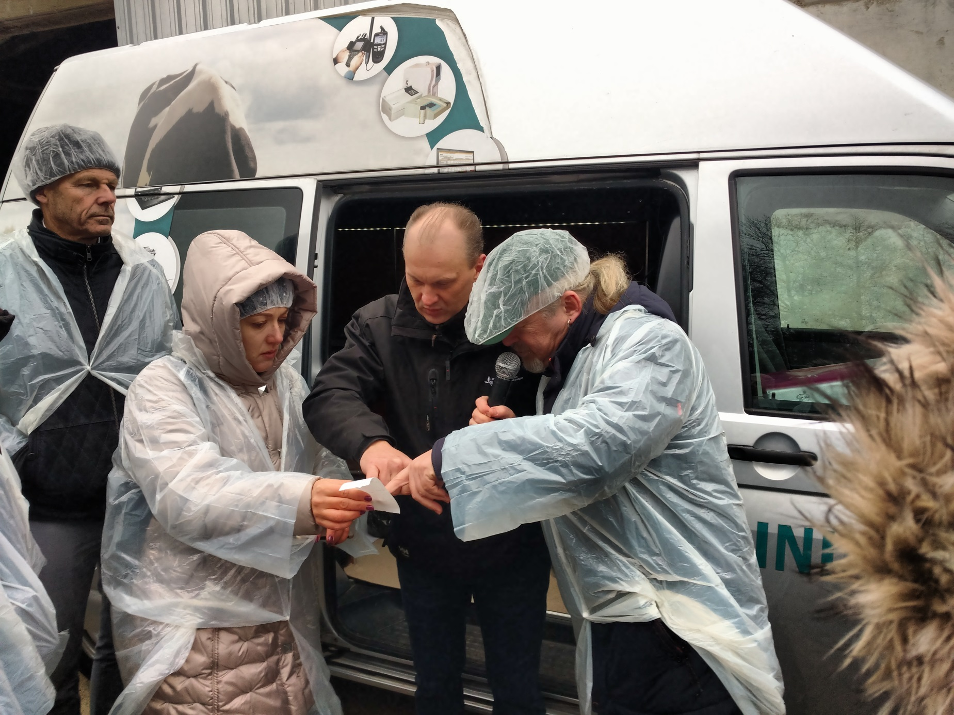
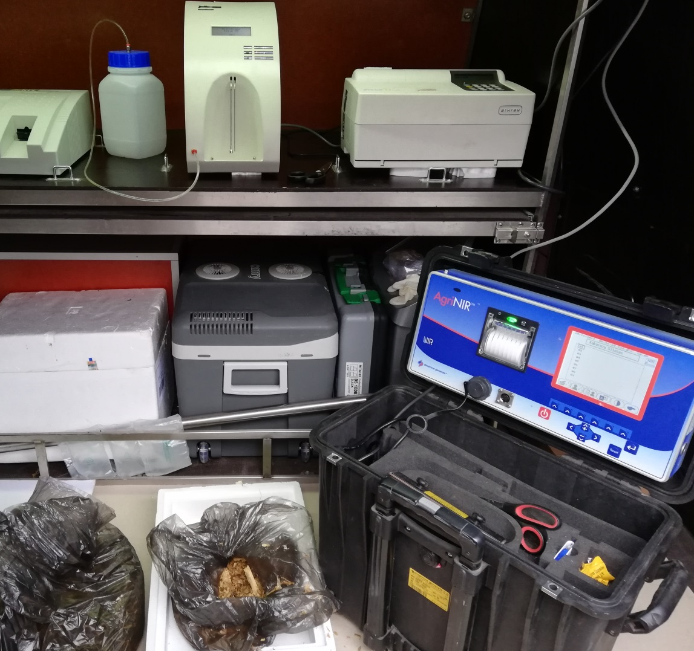
1.5.2 Strengthening farm advisory services within the AKIS
Mobile advisory units and measurement tools

Slide 53
1.5.2 Strengthening farm advisory services within the AKIS
linking different forms and methods of advisory work (individual advice, group advice, discussion groups, provide training, workshops, demonstration, etc.)
thematic or cross-cutting events to update advisors' knowledge,
after the privatization wave, give advisory services again a public role.
strengthen support from the AKIS for advisors (e.g. back-office)
cross-visits (learning peer-to-peer from other advisors / abroad)
freedom for new advisory themes and instruments (e.g. whole value chain approach, bio-based chains, dialogue with society,…)
spend time with enterpreneurs and researchers: link innovative investments or research facilities to advice (e.g. food pilot)

Slide 54
1.5.2 Strengthening farm advisory services within the AKIS
Region/country wide advisory networks for all advisors to share newly generated knowledge e.g after visits abroad
Support advisors' internships and placements in experimental research centres and training facilities, in cooperation with international partners
Dedicated actions to involve private advisors: not only training but other information flows e.g. use of common advisory tools, back-office support for all advisors public and private.
Support digitization of advisory work: fund establishment and maintenance cost of an IT knowledge platform, containing knowledge reservoirs, to be shared by several advisory bodies even across borders
Simplify administration and avoid dense control systems, rather manage the quality of advising

Slide 55
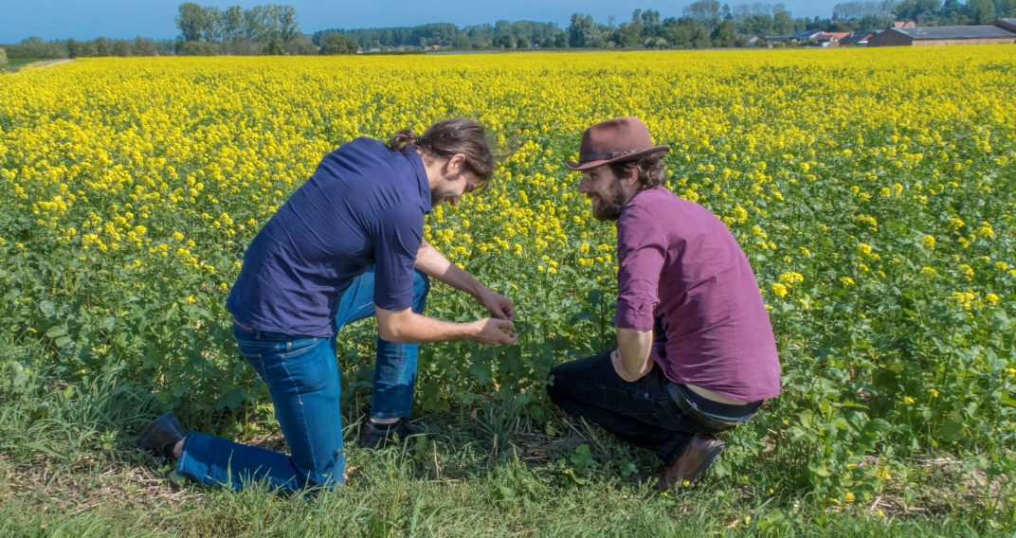
1.5.3 Incentivize interactive innovation projects
Involve education and young people in OGs
Reflect on a "before"life (platforms where actors regularly meet, funding for preparation) and an "after"-life (connect with other OG/MA projects)
Design a specific fund for after-project communication of innovative projects
Ensure sufficient coordination within MS and ensure that learning from each other is possible

Slide 56
1.5.3 Incentivize interactive innovation projects
Foresee sufficient funding for continuous OG calls, think about a set of calls: keep a bottom-up call & add further "suggestive" calls
enable advance payments and paying of farmers
Ensure involvement of advisors in EIP OGs and Horizon multi-actor projects, and give them multiple roles (see next slide)
CAP networks and knowledge reservoirs should help facilitate cross-border OGs (within one country and between countries)
Ensure a substantial budget for communication in each project and for dissemination in various ways, use existing channels which are most used
Peer-to-peer learning: organize cross-border visits for OGs or for specific actors who can incentivize (ISS, advisors, farmers' groups, …):

Slide 57
New roles for farm advisors in interactive projects
Preparing
OG proposal
Funding
the project
Farm advisors/innovation support services’ role in interactive innovation processes:
Capture practice needs
Broker to set up interactive innovation projects
Facilitate interactive innovation projects
Disseminate newly generated knowledge
+ ……bridge between CAP and Horizon programmes as innovation support service?
Notes:
Innovation brokering function
How to capture ideas?
Capturing bottom-up ideas from the grass-roots level
Getting an innovation project ready to start by acting as a go-between: helping single actors which might have difficulties in finding the adequate partners
A close connection with and understanding of agriculture is important
A cross-cutting approach beyond existing sectors, regions, initiative and institutes may bring added value
Different approaches may be useful e.g. vouchers etc ("simplified cost") for easier use and reduction of administrative burden

Slide 58
1.5.4 Support digital transition in agriculture
Interlink all public data to enable additional services, e.g. Lithuania RECAP app, Estonia GIS/LPIS based layers combining soil fertility, erosion zones, spreading harmful organisms etc, irrigation needs
Set up platforms to discuss how to manage the digital transition, find the needs (Austria)
Finance OGs on useful digital applications and make them publicly available for free, e.g. for pest management, recognising weeds, etc
Organise training on digital skills for farmers, advisors etc
Build knowledge reservoirs that are interactive and quality checked (eg LT, EURAKNOS), and use common standards as much as possible
Share digital advisory tools, reducing the maintenance cost

Slide 59
2 main instruments for future AKIS:
Innovation support service – "Innovation hub"
Back-office for advisors – "knowledge hub"
section 4.2 of the SCAR AKIS 4

Slide 60
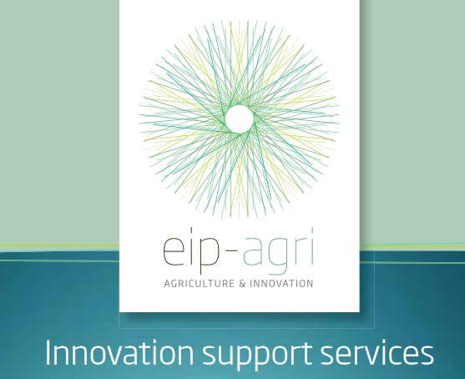
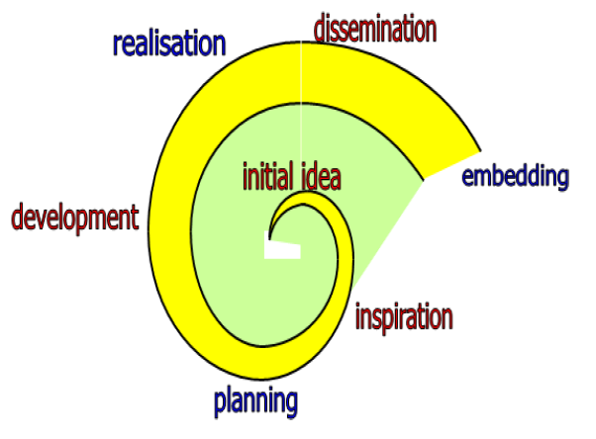
Example (LT): An Innovation Support Service combined with Back-office - Lithuanian Advisory Service
Department of Innovation
4 specialists: Head of Innovation Support Service; 2 Project Management Specialists; Interpreter. * Specialists of other departments are asked to take part in project activities only when expert knowledge is needed.
Functions:
collect and store information;
organize various activities;
initiate writing of proposals and take part in implementation of projects;
administer projects;
find human resources needed for implementation of projects;
co-ordinate dissemination of the results of innovation projects implemented;
co-ordinate collaboration among institutions.
E. Wielinga, 2016

Slide 61
Information System of Applied Research Results TITRIS - Free, Bilingual (LT/EN) Information System - Open Access
Information Database of the Backoffice
It collects, publicizes and compiles data on applied innovation research and innovations in the sector of agriculture in Lithuanian and English.
Object: non-commercial scientific research and practical innovations that have or might have influence on sustainable agricultural production.
Administrator: Innovation Support Service.
https://titris.lzukt.lt

Slide 62
Process of Data Submission and Publication in TITRIS
Information is sent by data provider
Information is evaluated by LAAS specialist
Information is reviewed by language editor
Information is published in TITRIS
An intensive search for information to complete TITRIS database is in progress at the moment.
All published information is available in a newsletter subscribed (in Lithuanian or English).

Slide 63
The SWG SCAR AKIS4 report will help….
https://ec.europa.eu/info/news/knowledge-and-innovation-unlocking-potential-food-and-farming-2019-sep-26_en
See in particular sections 1.2 What is AKIS?, 1.3 Multi-actor projects, 1.4 thematic networks, 1.5 possible actions for CAP AKIS Strategic Plans)
and chapter 4 (Advisors and advisory instruments and functions)
© European Union, 2018. | Images source: © darkovujic, #82863476; © Konovalov Pavel, #109031193; 2018. Fotolia.com

Slide 64
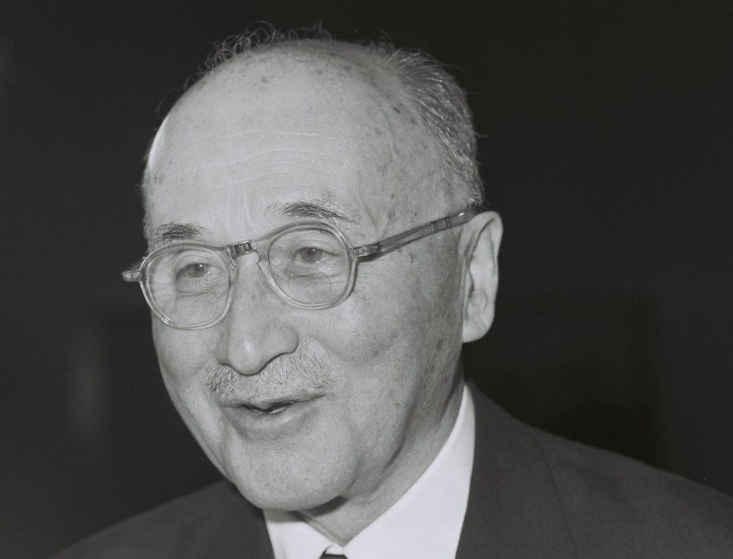
Jean Monnet
Father of Europe
12/05/1954
What post 2020 ?
“Ce qui nous arrête, c’est la peur du changement. Et pourtant c’est du changement que dépend notre salut”
“What stops us is the fear of change.
And nevertheless, it is on change that our salvation depends”

Slide 65
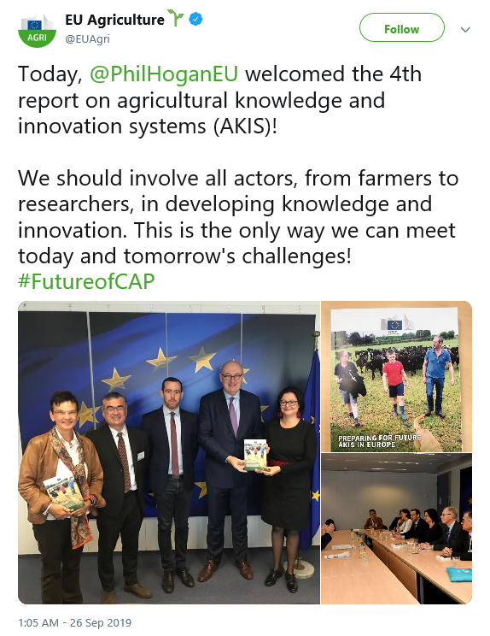
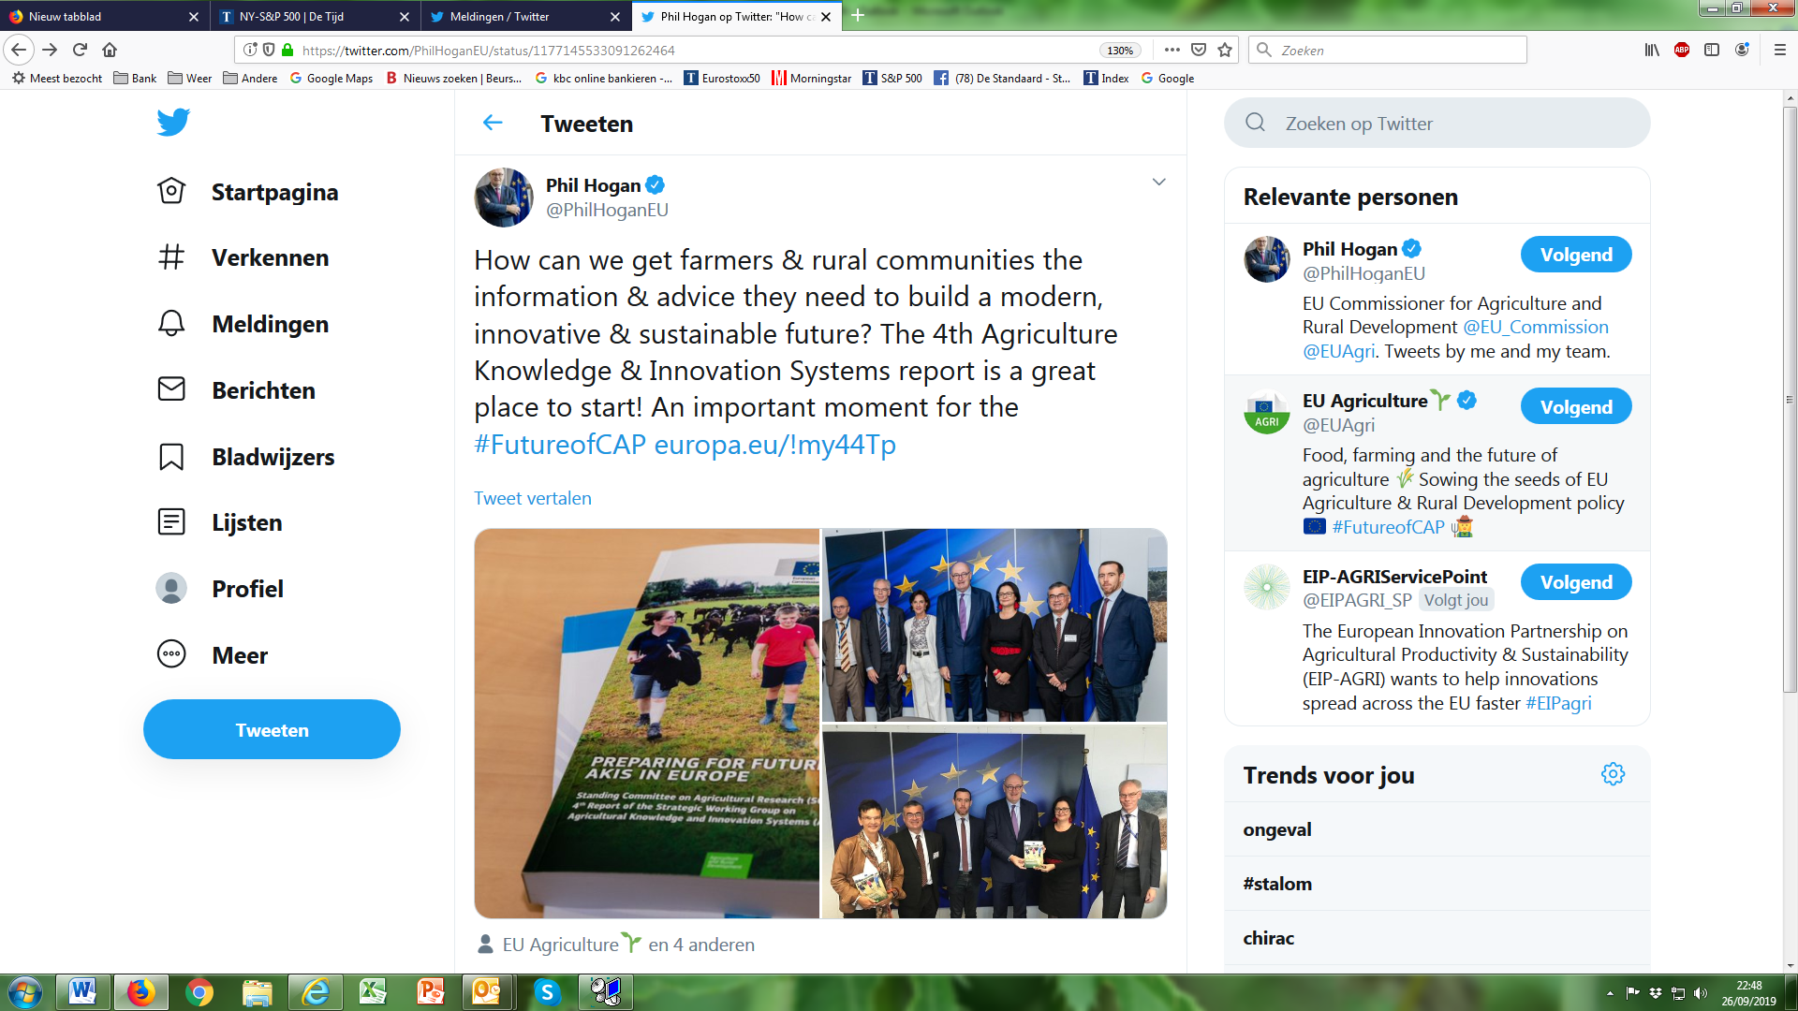
Handover AKIS4 report
to Commissioner Hogan
on 26 Sep 2019

Slide 66
CAP Future post 2020 – Key events:
26-27 March 2020: HR presidency high level research event on AKIS: “Bridging between science and practice” (Zagreb)
22-23 April 2020: EIP seminar on CAP Strategic Plans targeting AKIS strategies and interventions (Warsaw)

Slide 67
Building an "EU AKIS"
Speed up creativity and practice application
Better connectivity and quicker circulation of information

Slide 68
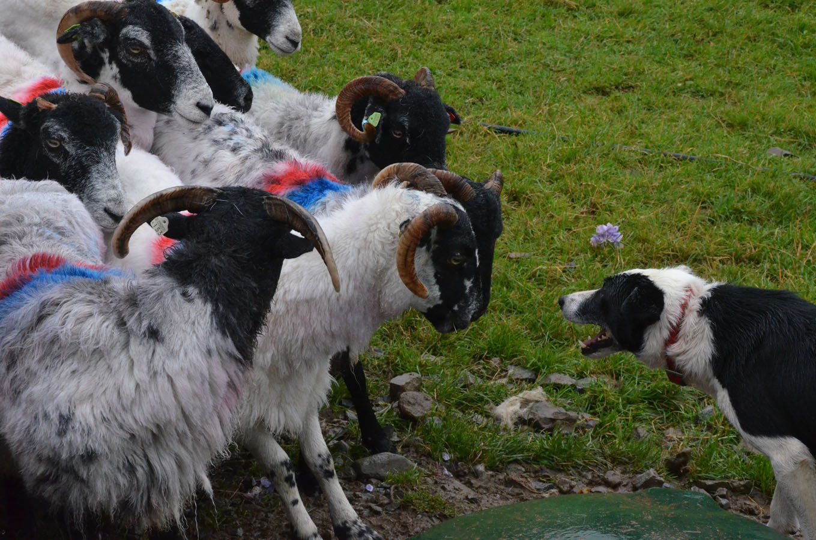
Speeding up knowledge exchange and innovation
Thanks for your attention
Inge Van Oost – DG AGRI Unit B.2 – Research and Innovation
Inge.Van-Oost@ec.europa.eu

